Slide 1
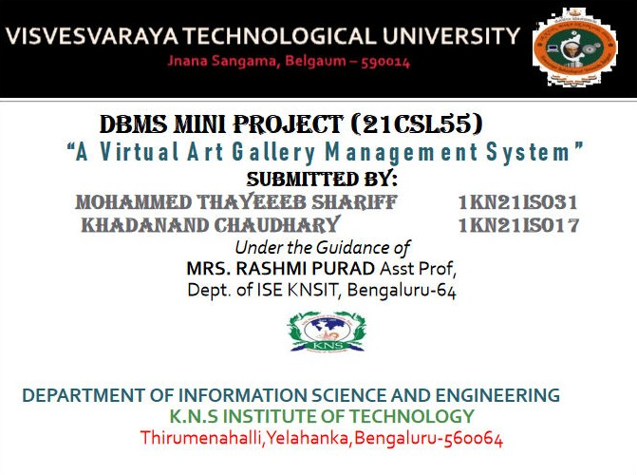

Slide 2

DBMS Mini Project
A Virtual Art Gallery Managemenet System with PHP and MySQL
Mohammed Thayeeb Shariff Khadanand Chaudhary

Slide 3








TABLE OF CONTENTS
About the Project
A breif shoutout of the general content & overview of the project
Sneak Peek
Here we Understand the SQLSchema, Diagrams, Codes.
01
04
Major Requirements
Discussion about the project Requirements, needs & scopes
02
05
Project Stages
Letting know more about the proposed system adv/dis adv & the results
Project Explanation
Letting you know more about the Project Pages
03
06
Conclusion
decribing the concluding part of the project

Slide 4
WHAT WE ARE WORKING ON IS
SECURE
providing a secure and convenient platform
ACCESSIBLE
Such that every one can use it
FAST AND RELIABLE
Enriching the overall gallery experience.

Slide 5







ABOUT THE PROJECT
It presents the design and implementation of a Virtual Online Art Gallery Management System (VOAGMS)
aimed at providing a seamless and immersive experience for art enthusiasts, collectors, and artists alike.
Leveraging cutting-edge virtual reality (VR)
technology and robust database management VOAGMS offers users the ability to explore diverse collections of artworks from the comfort of their own homes.

Slide 6
“Art is not what you see, but what you make others see.”
– Edgar Degas.
“To create one’s own world takes courage.”
- Georgia O’Keeffe.

Slide 7






SCOPE
Artwork & Exhibition
Management.
User Accounts & Art Sales and
Transactions.
Administrative Dashboard & Reviews, Subscriptions and Ratings.

Slide 8
Requirements
Windows 10 (Pro or higher)
HTML5, CSS, JavaScript, Ajax, MySQL 5x, jQuery, PHP
Web Server: XAMPP

Slide 9
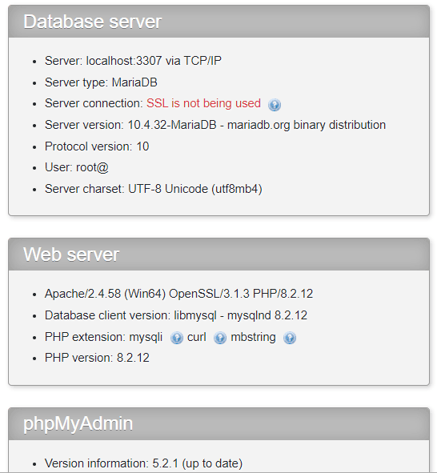

Slide 10
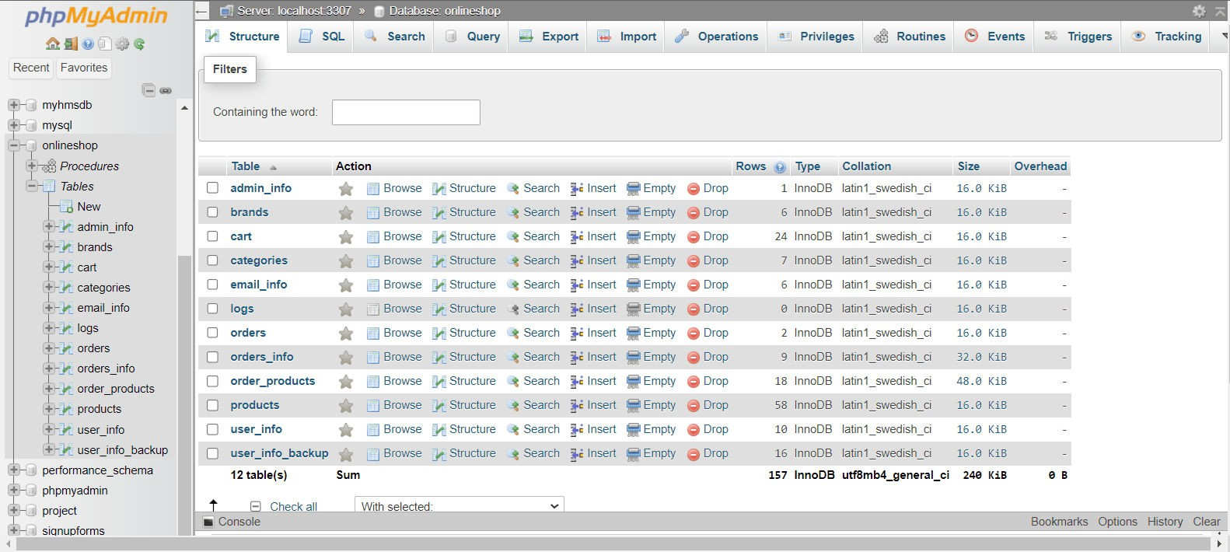
PHP SECTION

Slide 11
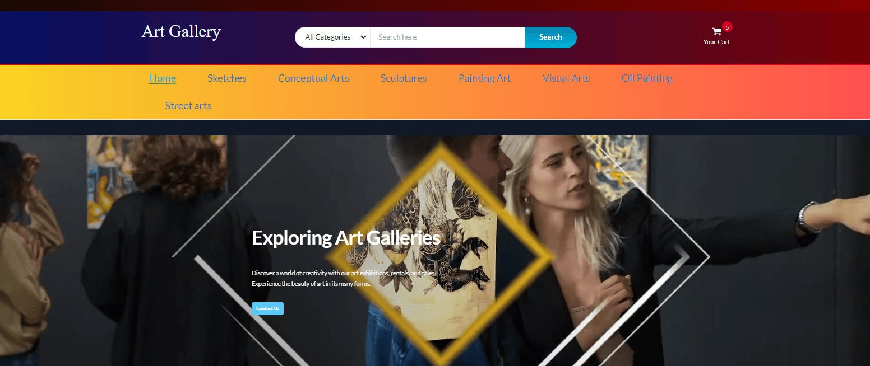
HOME PAGE

Slide 12
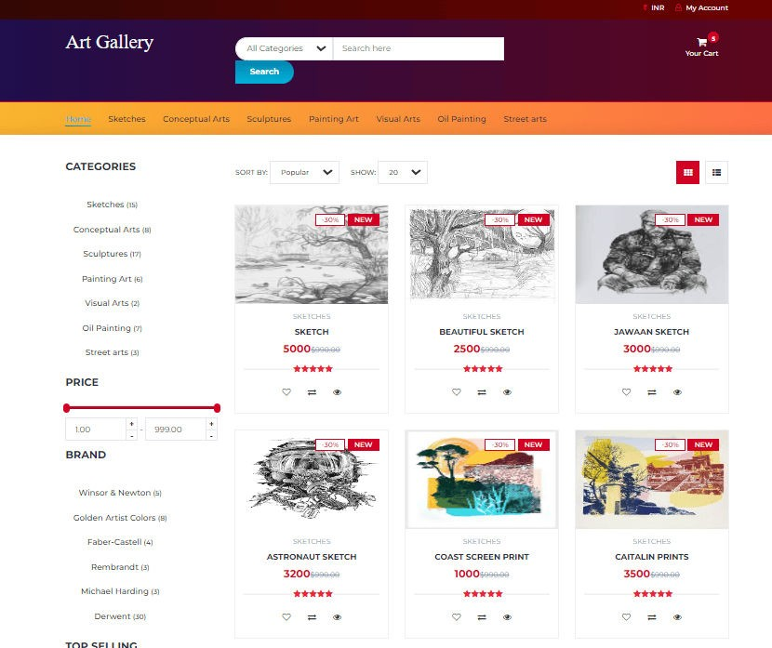
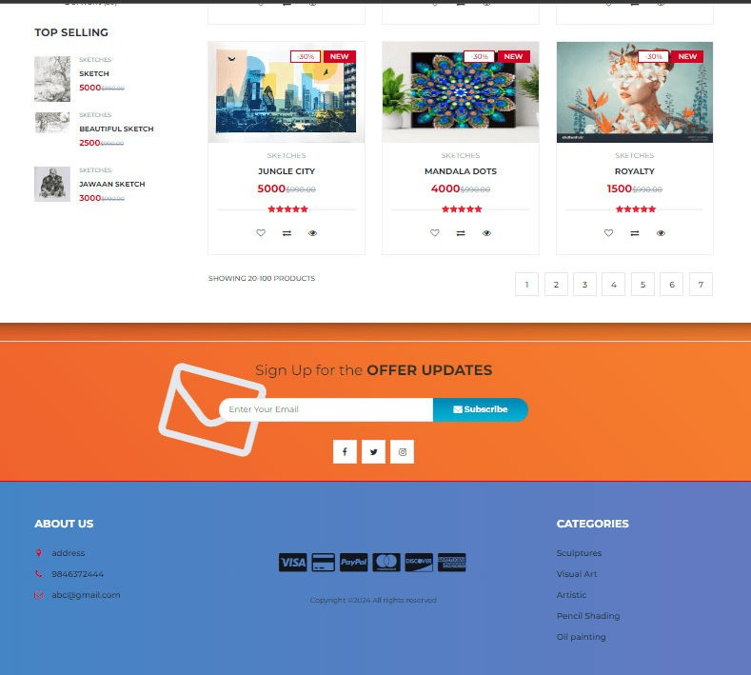
HERO SECTION

Slide 13
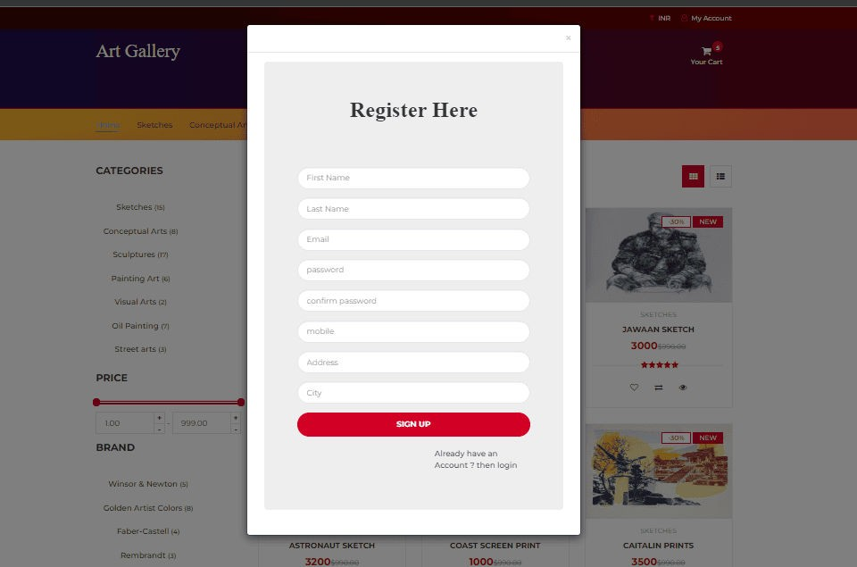
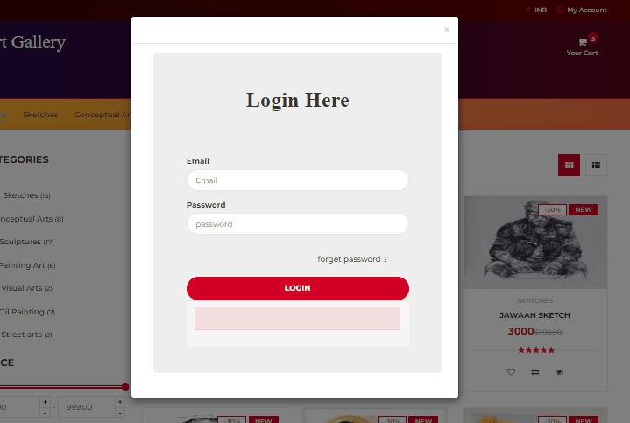
LOGIN/SIGN-UP SECTION

Slide 14
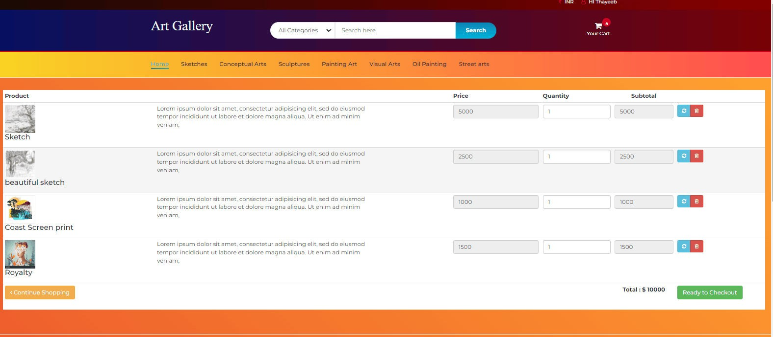
ADD TO CART SECTION

Slide 15
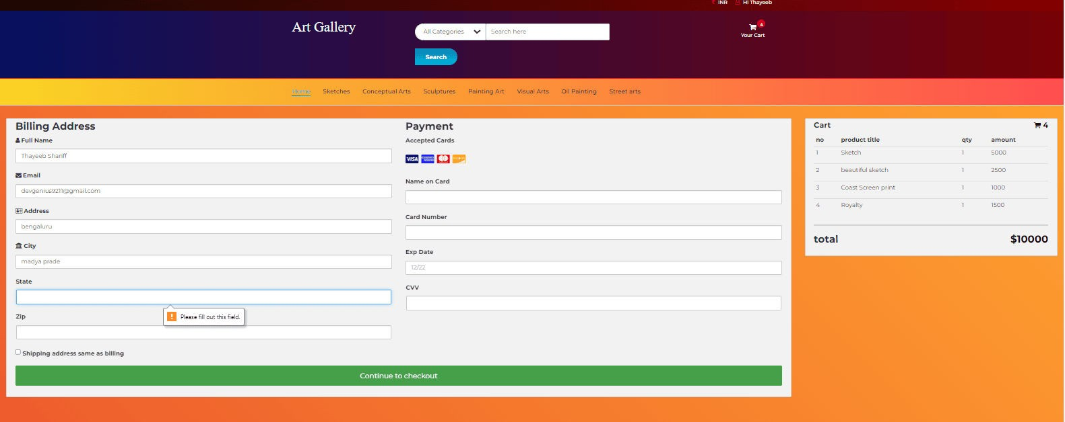
PRODUCT BILLING SECTION

Slide 16
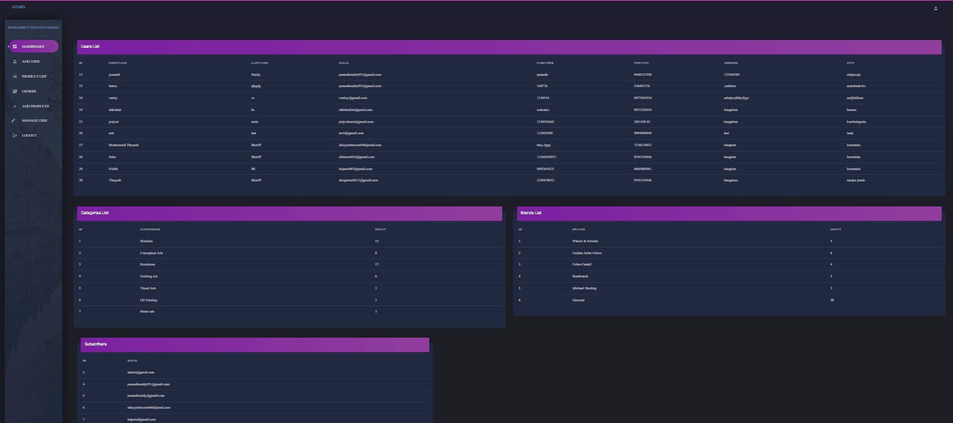
ADMIN DASHBOARD SECTION

Slide 17
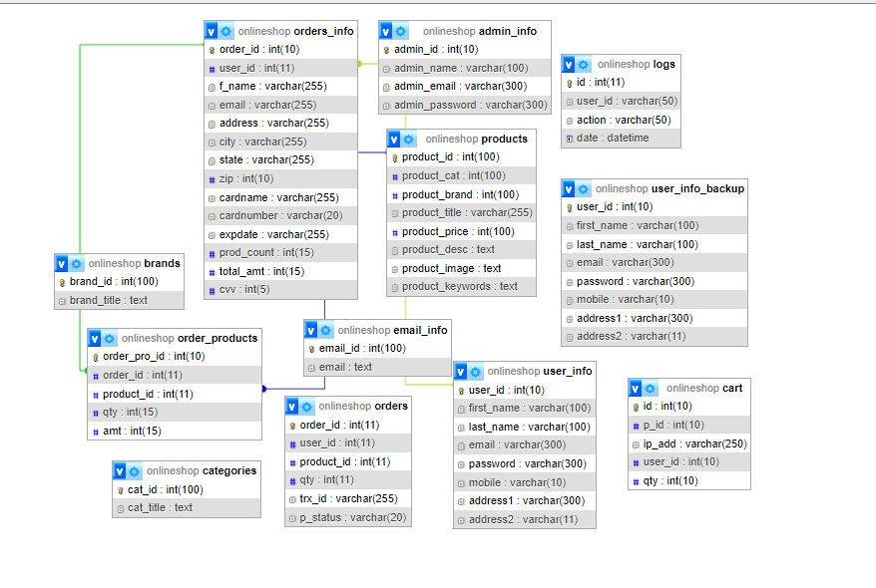
Er-Diagram

Slide 18
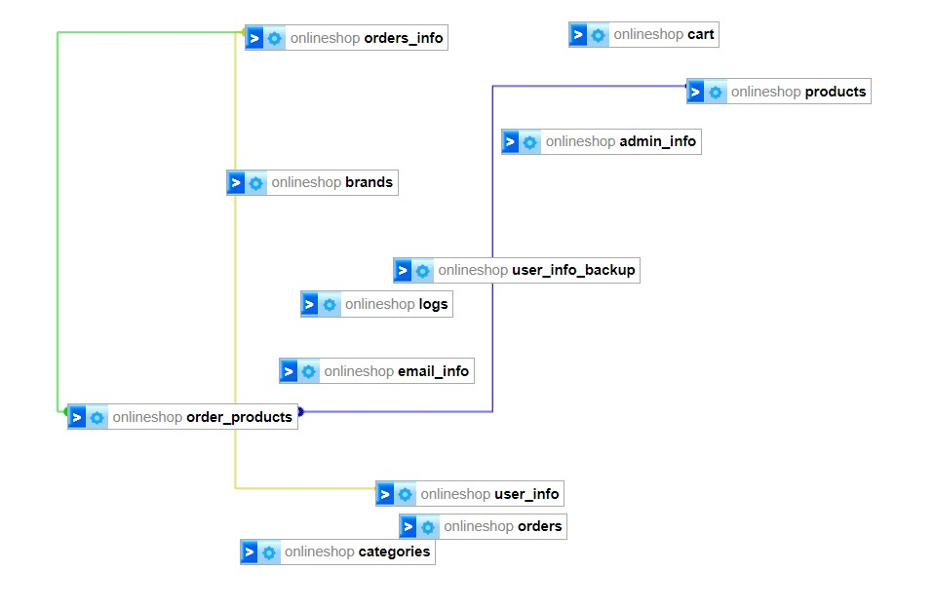
Schema

Slide 19
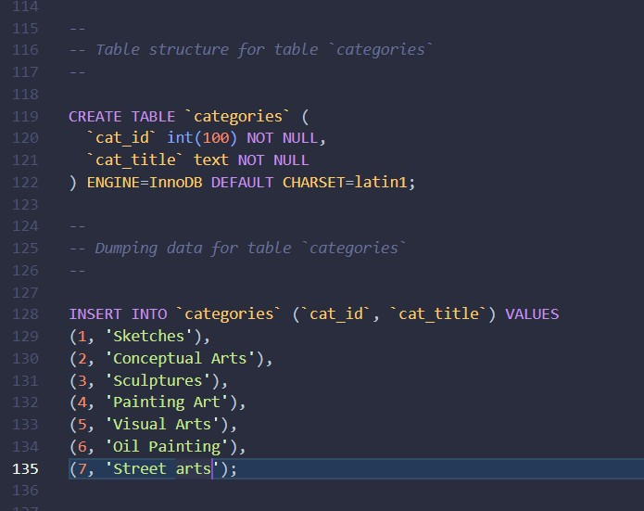
SQL CODE

Slide 20








PROJECT STAGES
STEP 2
user Registers and Makes a purchase. leaves a review & Star Ratings
STEP 1
VIsit The website Look
Around
STEP 3
User's Request is identified by the admin.

Slide 21




Benefits & advantages
Eﬃcient Organization
Inventory Management
Art exhibition
Enhanced User Experience
Accessible Information

Slide 22



Limitations
Initial Implementation Costs
Developing and implementing a robust Visual Art Gallery Management System may incur significant upfront costs in terms of software development, hardware, and staff training.
Technological Dependencies
Learning Curve
The system relies on technology, and any technical glitches or failures could disrupt gallery operations. Regular maintenance and updates are necessary.
Staff and artists may face a learning curve when adapting to the new system. Adequate training and support are essential to mitigate resistance.

Slide 23
CONCLUSION
Immersive Exploration: Experience lifelike art encounters without leaving home, enhancing accessibility for art enthusiasts.
Diverse Art Collection: Access a rich array of artworks and
styles, catering to varied tastes and preferences.
Interactive Engagement: Engage in discussions and share opinions with the art community, fostering a sense of connection and involvement.
Convenient Search: Effortlessly find specific artworks or
favorite artists through a user-friendly and efficient search system.
Anytime, Anywhere Access: Enjoy the flexibility of exploring the
gallery on multiple devices, allowing art appreciation at any time and from any location.

Slide 24




THE TEAM
Mohammed Thayeeb shariff
Tech Enthusiast | Software Engineer | Aspire to Learn things | Open for collaboration
Khadanand Chaudhary
Software Development Student | Web Development Enthusiast | Eager for Entry-Level Opportunities"

Slide 25




THANK-YOU!
Does anyone have any question?
devgenius9211@gmail.com
+91 73382 19832

